Slide 1
PRACTICAL EFFICIENCY OF MAXIMUM FLOW ALGORITHMS USING MA ORDERINGS AND PREFLOWS
Yuji Matsuoka,Satoru Fujishige, Journal of the Operation Research Society of Japan,Vol. 48, No. 4, 297-307, 2005
指導教授:王逸琳
學生:R36974143 劉文義
R36974046 張立蓁

Slide 2
Outline
Maximum Flow Problem
Definition
FMAP
Complexity
Computation Results
Conclusion

Slide 3
Maximum Flow Problem
In a capacitated network, we wish to send as much flow as possible between source node and sink node, without exceeding the capacity of any arc.

Slide 4

Definition(1/5)
N = (G = (V, A), s⁺, s⁻, c)
  V: node set
  A: arc set
  s⁺: source node
  s⁻: sink node
  c: capacity set,

Slide 5
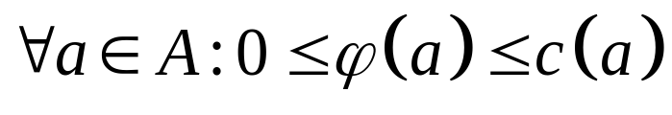
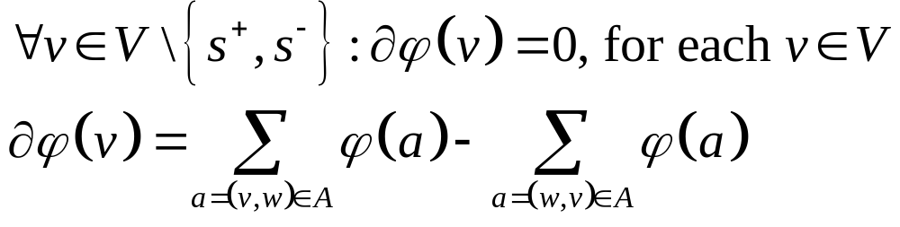
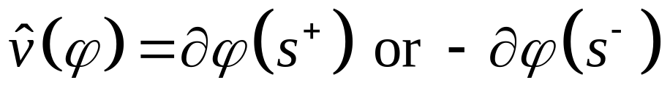
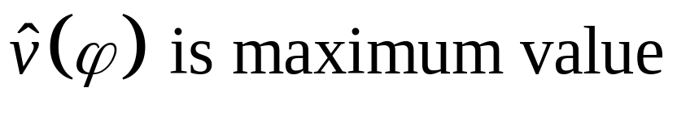
Definition(2/5)
Flow φ:
  Capacity constraints:
  Flow conservation:
The value of flow φ:
Maximum flow:

Slide 6
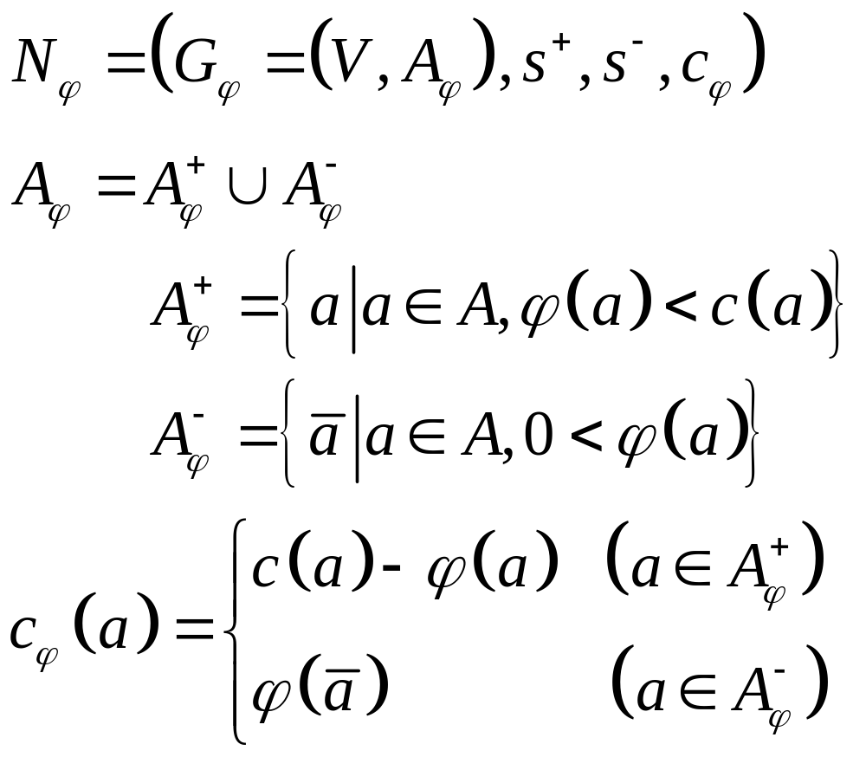
Definition(3/5)
Residual Network

Slide 7
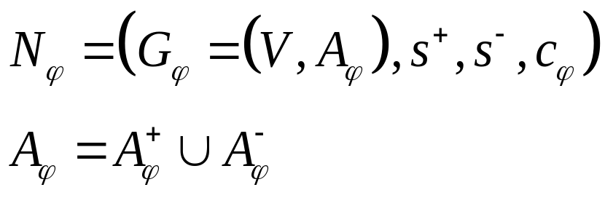
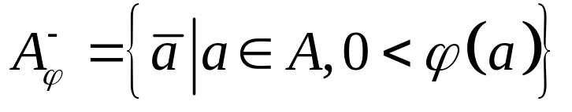
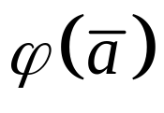
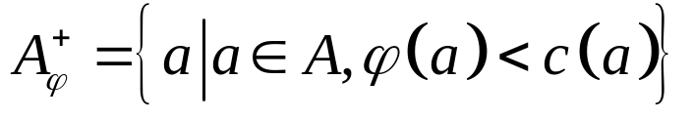
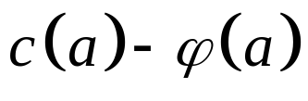
Definition(4/5)
Residual Network:
Capacity of arc (A, B) = 5 , Current flow = 3
3
A
5
B
2

Slide 8
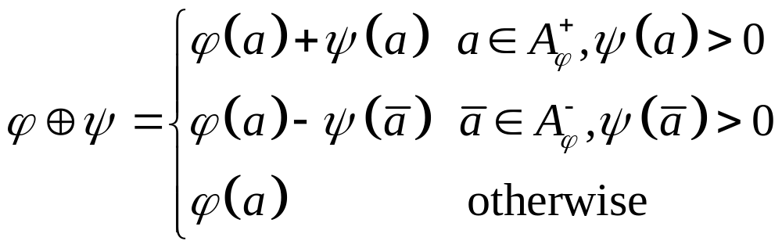
Definition(5/5)
Current network flow add residual network flow

Slide 9
FMAP
Step 0 : preflow push from s⁺
Step 1-1 : Obtaining MA-Ordeing from s⁻
Step 1-2 : Pushing preflows to s⁻
Step 2-1 : Obtaining MA-Ordering from s⁺
Step 2-2 : Pushing excess flows back to s⁺

Slide 10











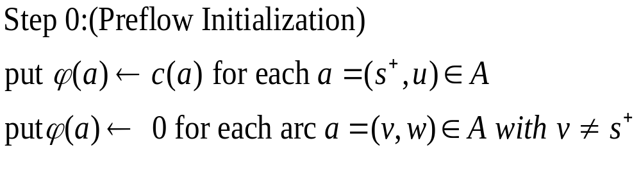
FMAP
2
4
4
6
9
1
2
7
2
1
6
3
3
3
1
5

Slide 11
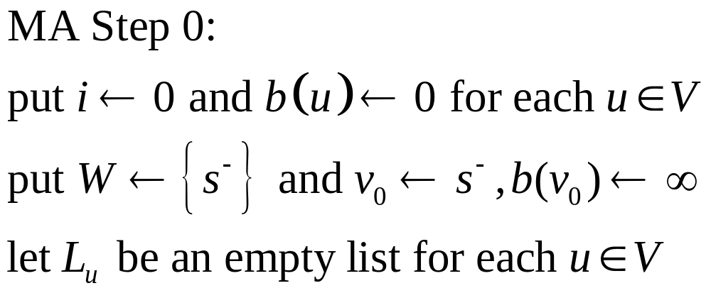
FMAP-STPE 1-1
W={6}
b(2)=0
b(4)=0
2
4
4
b(6)=0
b(1)=0
6
9
b(6)=∞
1
2
7
2
1
6
3
3
v₀=6
3
1
5
b(3)=0
b(5)=0
Step 1-1-1:(MA-Ordering from s⁻)

Slide 12
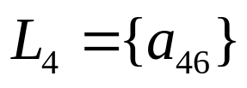
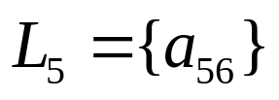
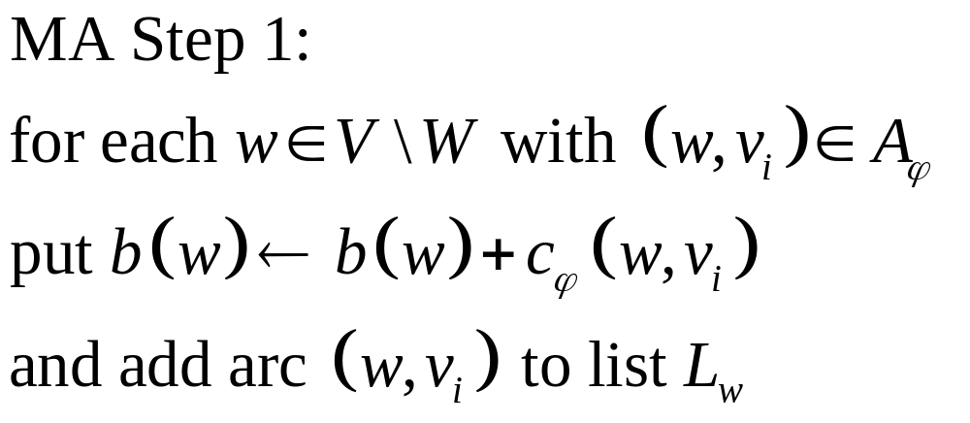
FMAP – STEP 1-1
b(2)=0
b(4)=0
b(4)=9
W={6}
2
4
4
6
9
b(6)=∞
1
2
7
2
1
6
b(1)=0
3
3
v₀=6
3
1
5
b(3)=0
b(5)=3
b(5)=0

Slide 13
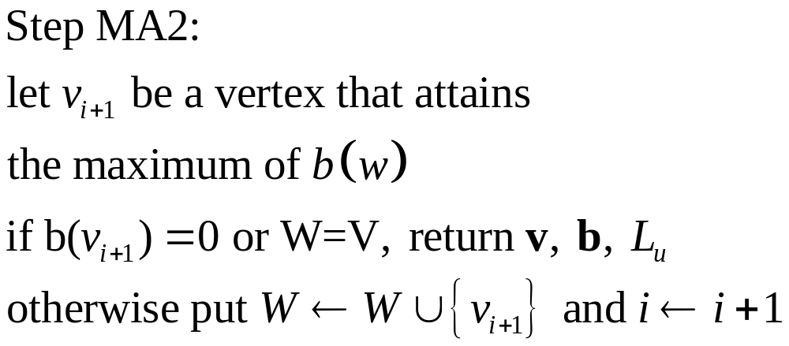
FMAP – STEP 1-1
b(2)=0
b(4)=9
W={6}
W={6,4}
4
v₁=4
2
4
6
9
b(6)=∞
1
2
7
2
1
6
b(1)=0
3
3
v₀=6
3
1
5
b(3)=0
b(5)=3

Slide 14
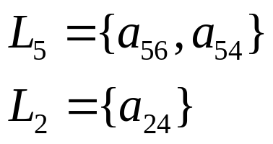
FMAP – STEP 1-1
b(2)=4
b(4)=9
b(2)=0
W={6,4}
4
v₁=4
W={6,4,5}
2
4
6
9
b(6)=∞
1
2
7
2
1
6
b(1)=0
3
3
v₀=6
3
1
5
b(3)=0
b(5)=5
b(5)=3
v₂=5

Slide 15
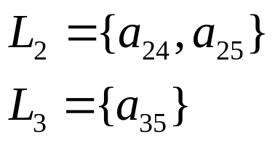
FMAP – STEP 1-1
b(2)=11
b(4)=9
b(2)=4
W={6,4,5}
W={6,4,5,2}
v₃=2
4
v₁=4
2
4
6
9
b(6)=∞
1
2
7
2
1
6
b(1)=0
3
3
v₀=6
3
1
5
b(3)=1
b(5)=5
b(3)=0
v₂=5

Slide 16
FMAP – STEP 1-1
b(2)=11
b(4)=9
v₃=2
4
v₁=4
W={6,4,5,2}
2
4
W={6,4,5,2,3}
6
9
b(6)=∞
1
2
7
2
1
6
b(1)=0
3
3
v₀=6
v₅=1
3
1
5
b(3)=1
b(5)=5
v₄=3
v₂=5
b(3) = 1 , b(1) = 0 v₄=3
b(1) = 0 stop!! Return (v₀~v₄) ,b, and L_{u}

Slide 17
FMAP – STEP 1-1
b(2)=11
b(4)=9
v₃=2
4
v₁=4
W={6,4,5,2,3}
2
4
6
9
b(6)=∞
1
2
7
2
1
6
b(1)=0
3
3
v₀=6
v₅=1
3
1
5
b(3)=1
b(5)=5
v₄=3
v₂=5

Slide 18


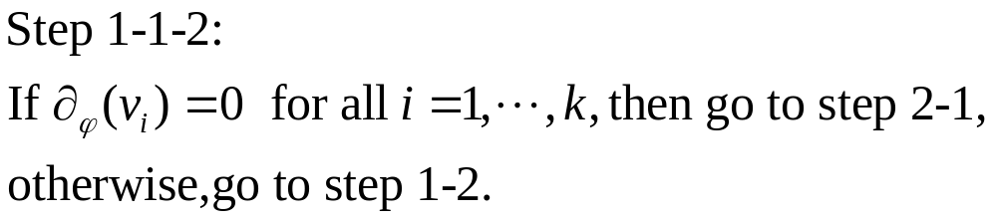


FMAP – STEP 1-1
v₃
v₁
2
4
4
9
7
2
6
3
v₀
3
1
5
v₄
v₂

Slide 19
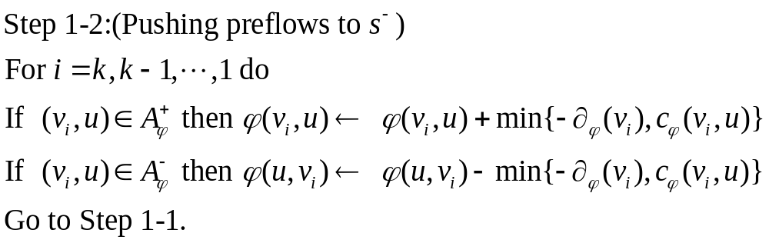
FMAP – STEP 1-2
v₃
v₁
2
4
4
9
7
2
6
v₀
3
3
1
5
v₄
v₂

Slide 20


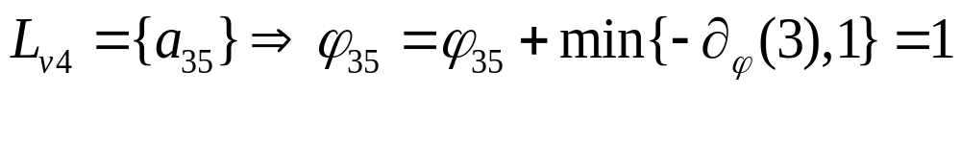
FMAP – STEP 1-2
v₃
v₁
2
4
6
v₀
3
5
v₄
v₂

Slide 21




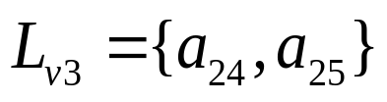
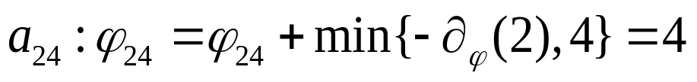
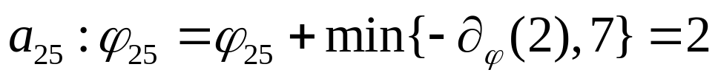
FMAP – STEP 1-2
v₁
v₃
4
2
4
2
6
v₀
3
1
5
v₄
v₂

Slide 22





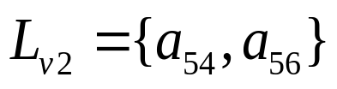
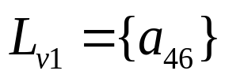
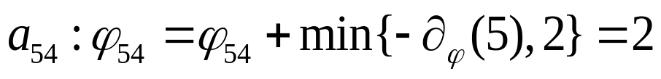
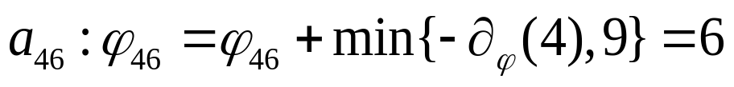
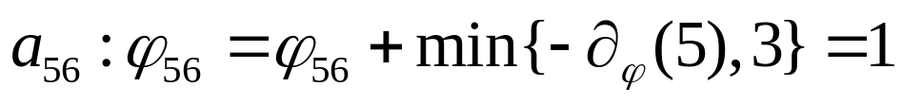
FMAP – STEP 1-2
v₁
v₃
4
2
4
6
2
2
6
v₀
1
3
1
5
v₄
v₂
Go to step 1-1 MA-Ordering from s⁻

Slide 23


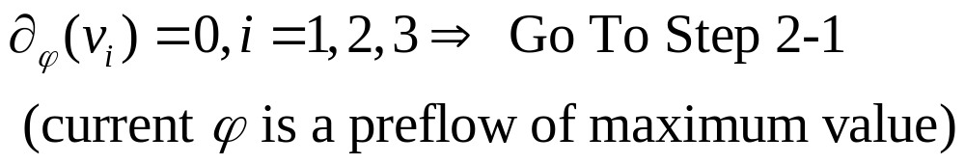
FMAP – STEP 1-1(iter2)
2
4
4
2
4
v₃
v₁
6
3
6
1
2
5
2
6
1
6
3
2
v₀
1
5
1
3
5
v₄
v₂

Slide 24
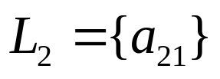
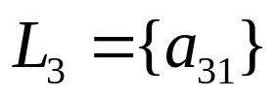
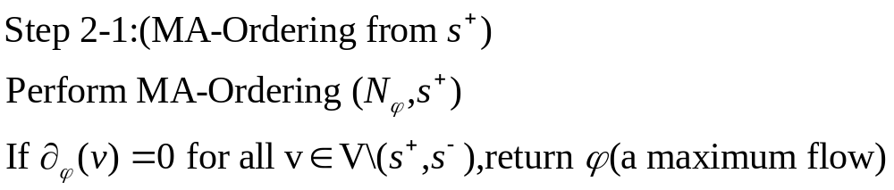
FMAP – STEP 2-1
b(2)=0
W={1}
b(2)=6
b(4)=0
2
4
4
6
3
b(1)=∞
6
1
2
5
2
1
6
v₀
2
3
b(6)=0
1
1
3
5
b(3)=0
b(3)=3
b(5)=0

Slide 25
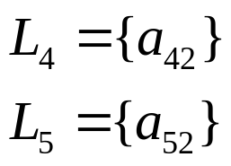


FMAP – STEP 2-1
v₁
b(4)=4
v₂
2
4
4
6
3
b(6)=6
6
1
2
5
2
1
6
v₀
2
v₃
3
1
1
3
5
b(3)=3
v₅
b(5)=2
b(5)=4
v₄
W={1,2}
W={1,2,4}
W={1,2,4,6}
W={1,2,4,6,5}
W={1,2,4,6,5,3}
b(3)=3 v₅=3
v₅=3,W={1,2,4,6,5,3} STOP!!

Slide 26




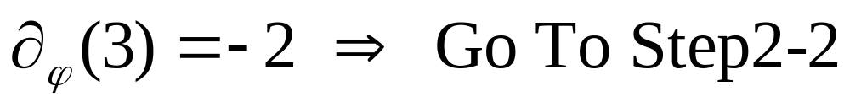
FMAP – STEP 2-1
v₁
v₂
FLOW CHART
2
2
4
4
4
6
6
1
1
6
v₀
1
2
2
v₃
1
6
1
3
3
5
v₅
v₄
3
1
5

Slide 27
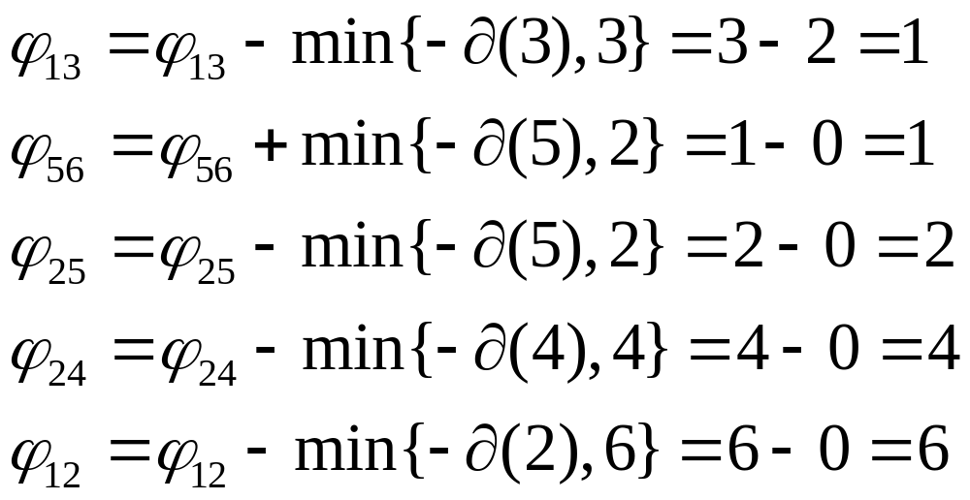
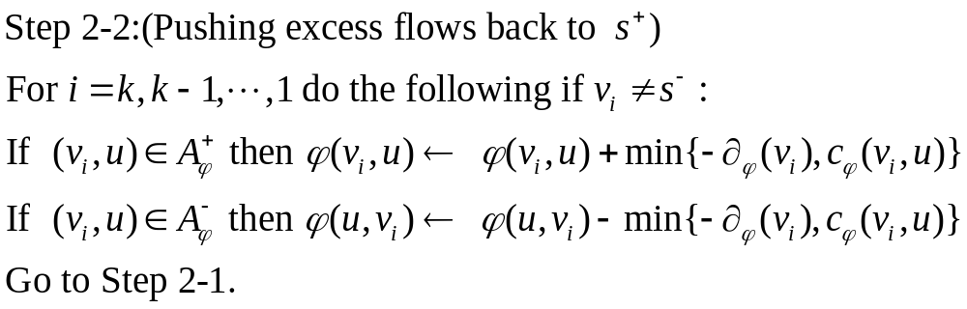
FMAP – STEP 2-2
2
4
4
6
3
6
1
2
5
2
1
6
3
2
2
1
1
1
3
5

Slide 28

FMAP – STEP 2-1(iter2)
v₁
v₂
2
4
1
1
6
v₀
v₃
3
5
v₅
v₄
Maximum flow = 7

Slide 29
Complexity(MA-Ordering STEP 0)
Int i=0; Int b[u]; W ←{s⁻} ; v₀ ←s ; O(1)
For int u=1;u<=n;u++
{
b[u]=0;
} O(n)
B[v₀]=∞ ； O(1)
Step MA2： O(n)

Slide 30

Complexity(MA-Ordering STEP 1)
Create-Fibonacci heap(H); O(1)
ChangeKey(b(w), H); O(1)
∵ b(w) is updated by arcs. ∴ O(m)
MA STEP1: O(m)

Slide 31
Complexity(MA-Ordering STEP 2)
Delete(b(w), H) O( log n)
∵ v₁,v₂,……v_{k} Delete(b(w), H) runs O(n) times.
∴ Step MA2：O(n log n)
∴ The complexity of Procedure MA ordering is O(m + n log n)

Slide 32
Complexity(FMAP STEP 0)
FMAP STEP0: O(m)

Slide 33
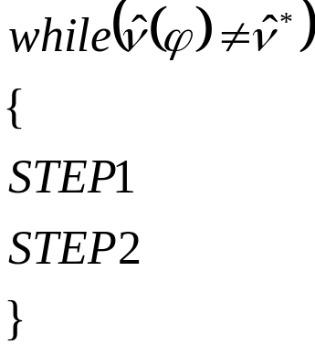
Complexity(FMAP STEP 1)
Step 1-1-1:(MA-Ordering from s⁻)
FMAP STEP 1-1-1: O(m + n log n)
O(m)
O(m)
∵ O(n log nU ) times
∴FMAP：O(n ( m + n log n) log nU)

Slide 34
Computational setup
TOSHIBA WXPHESP1 JP001
CPU：Intel Pentium M, CPU 1.30 GHz
RAM：512MB
OS：Microsoft Windows XP Home
Edition verson2002.

Slide 35
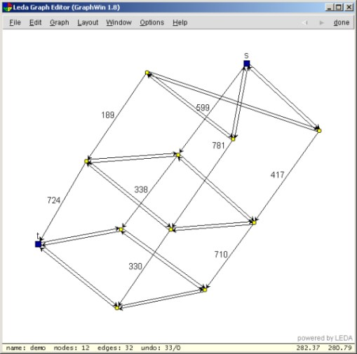
GENRMF Family：
n : a²b
m :5a²b-4ab-a²
GENRMF-LONG：
n=2^{x} a=2^{x/4} b=2^{x/2}
c₁=1 c₂=10000
GENRMF-LONGER：
n=2^{x} a=4 b=2^{x-4}
c₁=1 c₂=10000
GENRMF-WIDE：
n=2^{x} a=2^{2x/5} b=2^{x/5}
c₁=1 c₂=10000
c(a)=c₂*a*a
c(a)=[c₁,c₂]

Slide 36
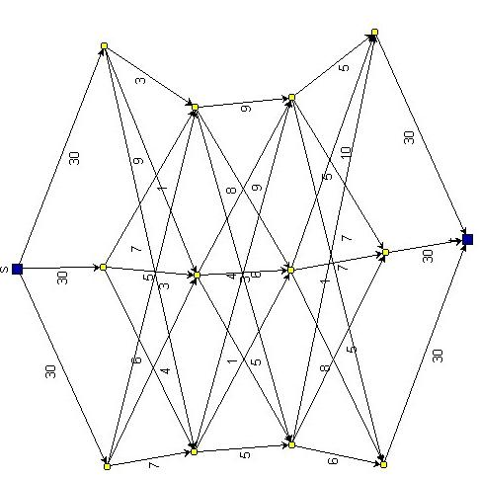
WASHINGTON Family
n : ab+2
m :3ab-b
WASHINGTON-RLG-LONG ：
n=2^{x} a=64 b=2^{x-6}
c=10000
WASHINGTON-RLG-WIDE ：
n=2^{x} a=2^{x-6} b=64
c=10000

Slide 37
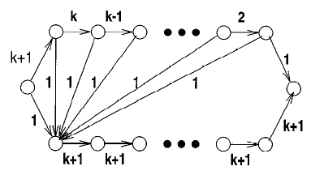
AK Family(1)

Slide 38
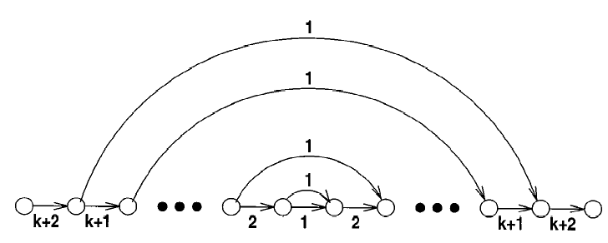
AK Family(2)

Slide 39
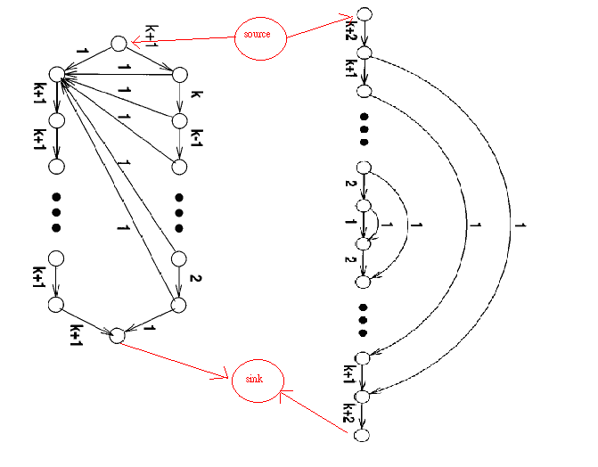
AK Family(3)

Slide 40
Experiment
Authors made computatinal experiments for
the following four programs:
FMA、FMAP、Q_PRF、HI_PR

Slide 41
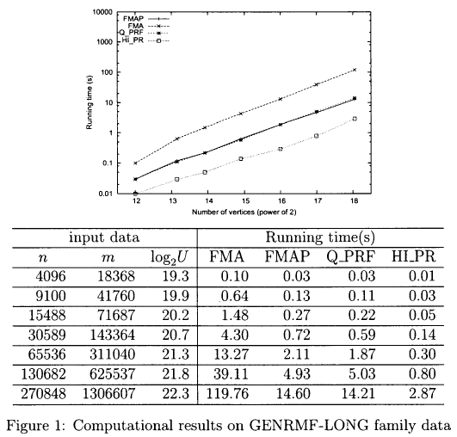
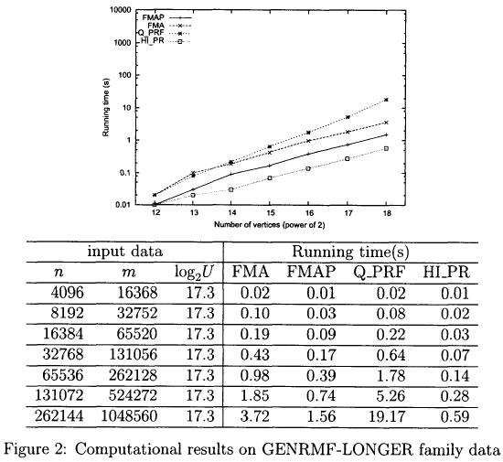
Computational results(1)

Slide 42
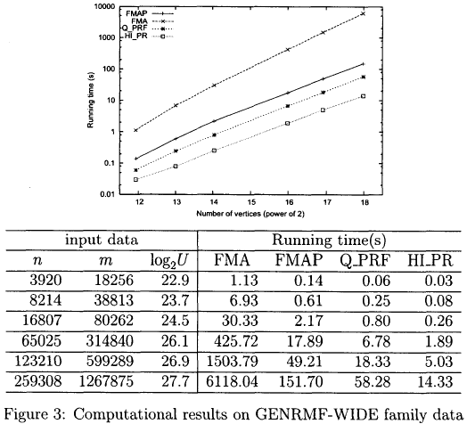
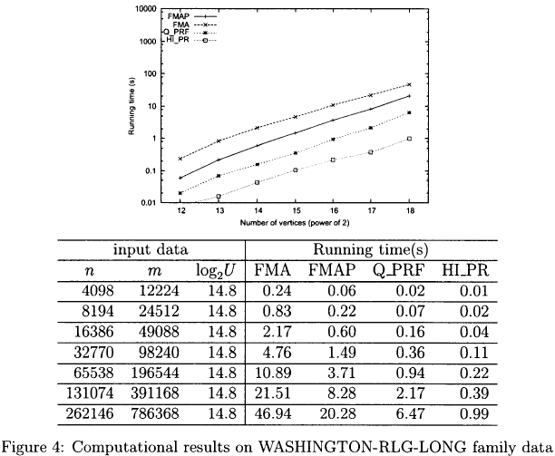
Computational results(2)

Slide 43
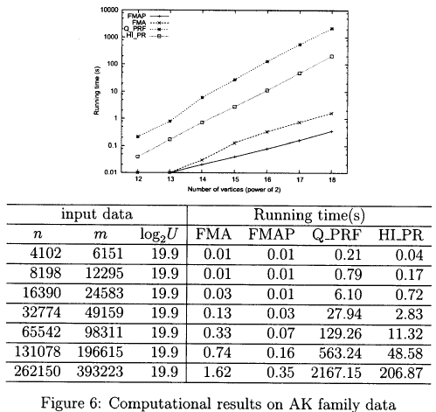
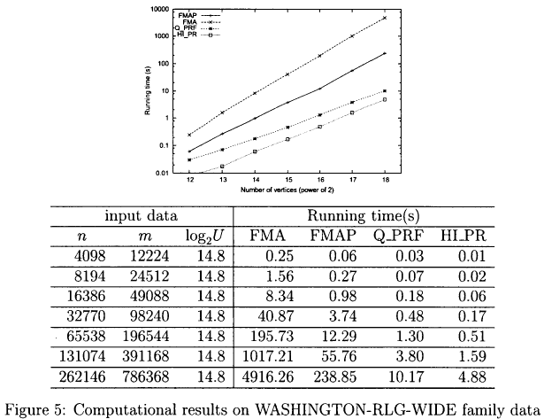
Computational results(3)

Slide 44
Conclusion
Authors have presented an improved version of Fujishige’s algorithm. The improved version is faster than the original version.
While Goldberg and Tarjan’s algorithm maintauns a locally valid order,our improvedalgorithm performs global ordering and global operations.

